Slide 1

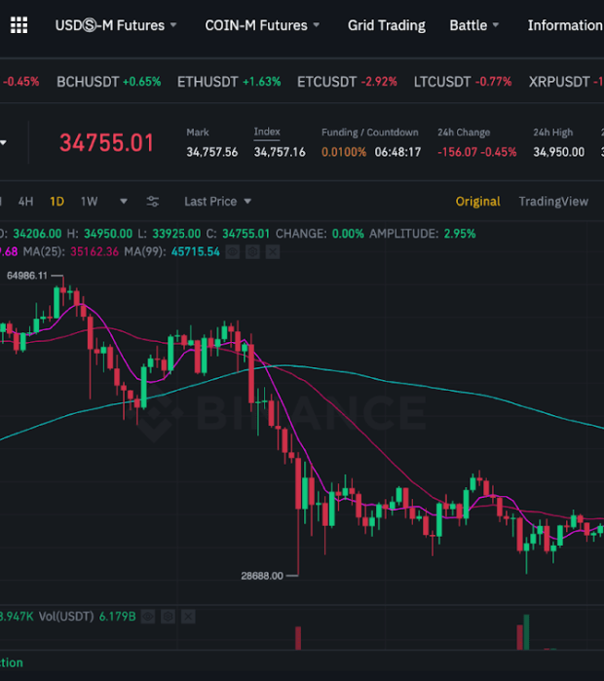
Crypto Decryption

Slide 2
Project overview
Provide users with a tool that allows them to observe insights into top traded five cryptocurrencies on Binance.
Bitcoin
Etherium
Cardano
Ripple
Solana
Using the interactive visualisations, the users can get more information about:
Historical candlestick chart of crypto prices for various time intervals
Live candlestick charts with real time prices from Binance
Historical charts of asset volumes and number of trades for each crypto currency

Slide 3
Why Crypto and Why Binance?
Crypto because…
The global economy is inevitably moving towards a digital eco-system. From investment to money transfer, everything is going paperless.
The newest and most promising addition to the digital payment sector is cryptocurrency.
Over the last couple of years, digital currency has been rapidly gaining the public eye.
Binance because…
Binance is currently the largest exchange in the world in terms of daily trading volume of cryptocurrencies.

Slide 4
Steps taken to accomplish the interactive live visualisations
Connect to Binance API and collect data for kline (candlestick) endpoints for two series
Store the fetched data in SQLite database
Create routes for different endpoints in Flask app
Query data from SQLite database
Use JavaScript to call endpoints from Flask app
Build visualisations in JavaScript and render in HTML
Use Websocket to connect to Binance server and fetch data from kline (kandlestick) endpoints

Slide 5
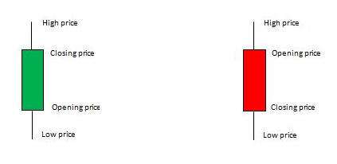
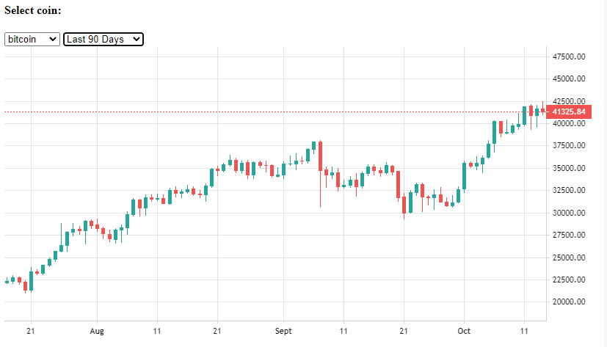
Historical candlestick charts
Using the drop-down menu, the user can select the crypto of interest and set the time interval for visualization.
Time period are:
1 year, 90 days, 7 days
A candlestick chart is a method of showing prices — namely open, high, low and close — of an asset for a defined period, giving a good summary of the price's behavior.

Slide 6
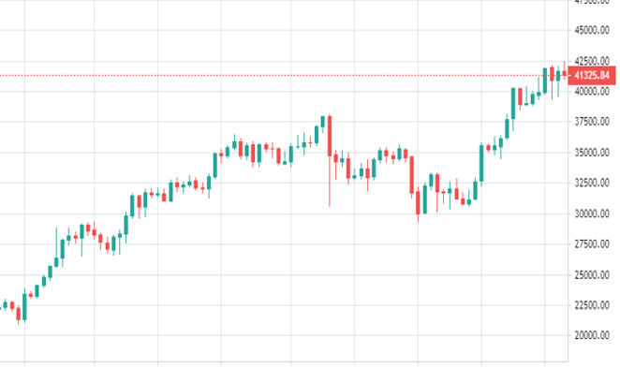
Live candlestick charts
Live chart has the same functionality as the historical chart but uses live data. The data is presented for each minute over the previous day and is updated each minute as new data is available from Binance.
The user can interact with the chart by selecting which coin is displayed, and also zooming in and out of the chart.

Slide 7
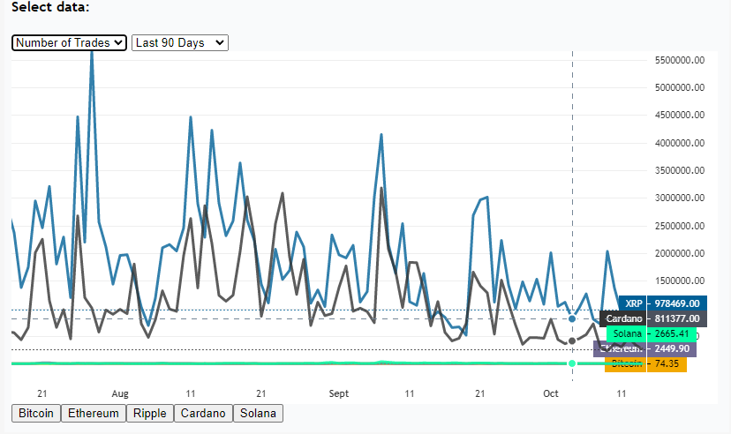
Historical trade data
Historical trade chart allows the user to visualize the number of trades for each crypto currency within a specific time frame.
It is evident from the chart that cardano and ripple process much greater number of trades compared to bitcoin and etherium. This could be related to their significant price difference.

Slide 8
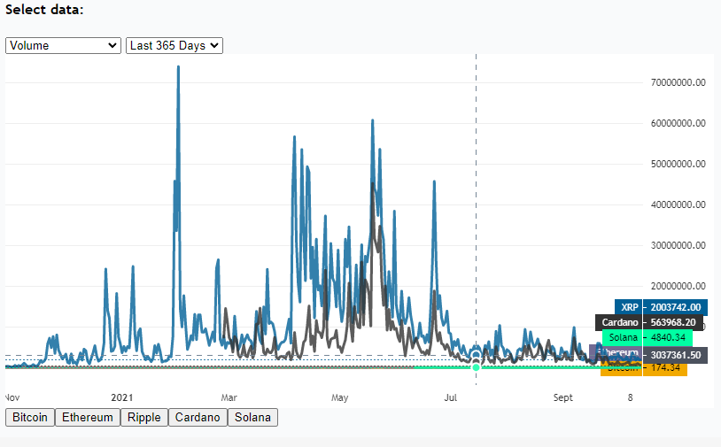
Historical crypto volume chart
The historical volume chart gives the user in insight into the total amount of assets traded during specific time frame.
Trading volume is an important metric which is frequently used to evaluate the investment potential of an emerging digital currency.
The chart shows that some major cryptos like bitcoin are lower in terms of total traded asset volumes since their price is significantly higher which reduces its volume in circulation.

Slide 9
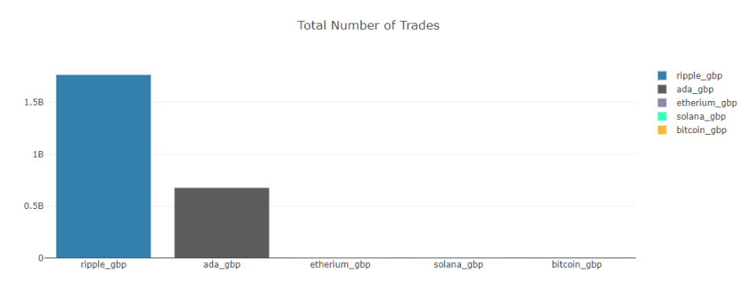
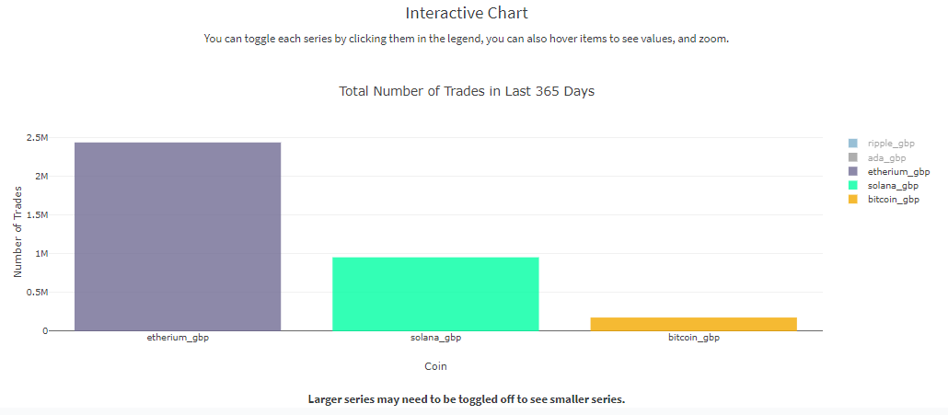
Total sum of trades for the last year
This chart shows the sum of number of trades for each crypto currency for the last one-year time frame.
It is evident that ripple by far exceeds other cryptocurrencies followed by cardano.

Slide 10
Conclusion
This project aims to:
Showcase our visualisations to active community of traders and help them get a better insight into major cryptocurrencies and make investment decisions
Display interactive charts and provide intuitive and flexible platform for analyzing historical data of cryptocurrencies
Provide user-friendly dashboard with interactive charts for any user to build an understanding of cryptocurrency price behavior and trade activities for any given time frame

